Slide 1

Introduction to C

Slide 2
Languages
Programmers write instructions in various programming languages, some directly understandable by computers and others requiring intermediate translation steps.
These may be divided into three general types:
Machine languages
Assembly languages
High-level languages

Slide 3
Machine languages
+1300042774 +1400593419 +1200274027
Any computer can directly understand only its own machine language
Machine languages generally consist of strings of numbers (ultimately reduced to 1s and 0s) that instruct computers to perform their most elementary operations one at a time.
Such languages are cumbersome for humans
+1300042774
+1400593419
+1200274027

Slide 4
Assembly languages
English-like abbreviations to represent elementary operations.
These abbreviations formed the basis of assembly languages.
Translator programs called assemblers were developed to convert assembly-language programs to machine language at computer speeds
LOAD BASEPAY
ADD OVERPAY
STORE GROSSPAY

Slide 5
High-level languages
To speed the programming process, high-level languages were developed in which single statements could be written to accomplish substantial tasks.
The translator programs that convert high-level language programs into machine language are called compilers.
High-level languages allow programmers to write instructions that look almost like everyday English and contain commonly used mathematical notations.
grossPay = basePay + overTimePay

Slide 6
History of C
C evolved from two previous languages, BCPL and B.
BCPL was developed in 1967 by Martin Richards as a language for writing operating-systems software and compilers.
Ken Thompson modeled many features in his B language.
Both BCPL and B were “typeless” languages—every data item occupied one “word” in memory.

Slide 7
The C language was evolved from B by Dennis Ritchie at Bell Laboratories in 1972.

Slide 8
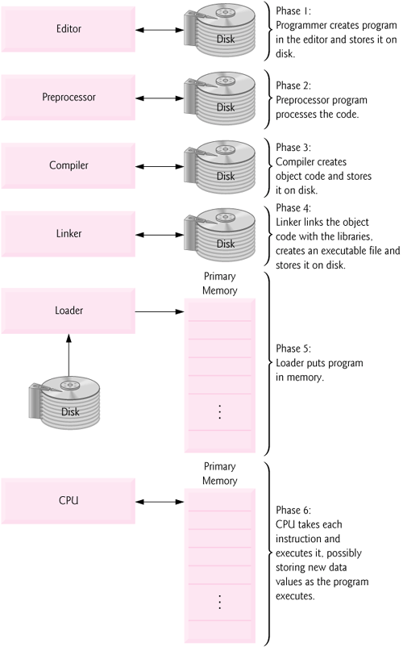

Slide 9
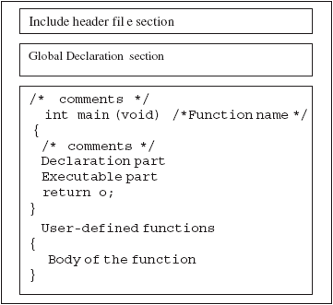

Slide 10
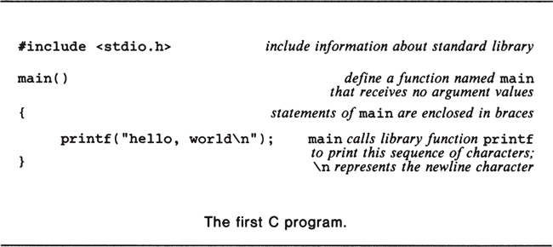

Slide 11
PROGRAMMING RULES
Every program should have main() function.
C statements should be terminated by a semi-colon.
At some places, a comma operator is permitted.
All statements should be written in lowercase letters. Generally, uppercase letters are used only for symbolic constants.
The user can also write one or more statements in one line separating them with a semicolon (;). Hence, it is often called a free-form language.
The following statements are valid.
a=b+c; d=b*c; ora=b+c; d=b*c;
The opening and closing braces should be balanced, i.e. if opening braces are four; closing braces should also be four

Slide 12
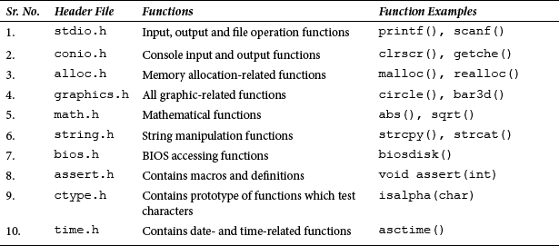

Slide 13
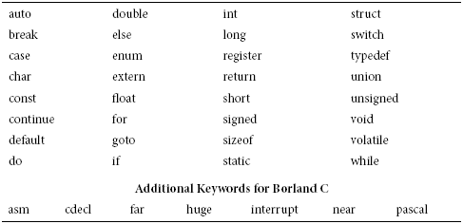

Slide 14
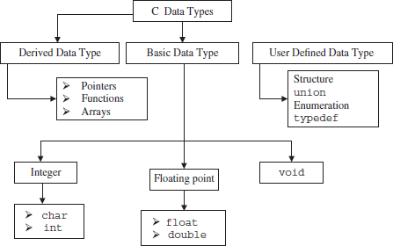

Slide 15
DECLARING VARIABLES
The declaration of variables should be done in declaration part of the program.
The variable must be declared before they are used in the program. Declaration ensures two things.
(i) Compiler obtains the variable name.
(ii) It tells to the compiler data type of the variable being declared and helps in allocating the memory.
The variable can also be declared before main() such variables are called external variables.

Slide 16
The syntax of declaring a variable is as follows.
Data_type variable_name;
Example:
int age;
char m;
float s;
double k;
int a,b,c;

Slide 17

INITIALIZING VARIABLES
variable_name = constant; or data_type varaible_name= constant;
Variables declared can be assigned or initialized using assignment operator ‘=’.
The declaration and initialization can also be done in the same line.
variable_name = constant; or data_type varaible_name= constant;
int y=4;

Slide 18
Types, Operators, and Expressions
Variables and constants are the basic data objects manipulated in a program.
Declarations list the variables to be used, and state what type they have and perhaps what their initial values are.
Operators specify what is to be done to them.
Expressions combine variables and constants to produce new values.

